Slide 1
Homelessness and Mental Health
Dr Steph Grohmann

Slide 2
Learning outcomes
After this lecture you will
Understand the complex two-way relationship between homelessness and mental health
Be aware of the impact of trauma and childhood adversity on later homelessness
Understand the impact of ongoing social exclusion on homeless people’s mental health
Know about barriers to mental health care for people who are homeless

Slide 3
Definitions: homelessness
ETHOS - European Typology on Homelessness and Housing Exclusion
Rooflessness: without a shelter of any kind, sleeping rough
Houselessness: with a place to sleep but temporary in institutions or shelter
Living in insecure housing: threatened with severe exclusion due to insecure tenancies, eviction, domestic violence
Living in inadequate housing: in caravans on illegal campsites, in unfit housing, in extreme overcrowding
FEANTSA is the European Federation of National Organisations Working with the Homeless. https://www.feantsa.org/

Slide 4
Definitions: homelessness
Scottish Government
A person is homeless if they:
have no accommodation in the UK or elsewhere, which they are entitled to occupy together with other members of their household
have accommodation, but it is not reasonable to continue to occupy it
have accommodation, but cannot secure entry to it
have accommodation, but occupation of it will probably lead to abuse or threats of abuse from someone who lives there or from someone who previously resided with the applicant in that accommodation or elsewhere
have accommodation, but it is moveable (such as a caravan or houseboat) and there is nowhere to place it and live in it
have accommodation, but this is overcrowded and may endanger the health of the occupants.
A person is threatened with homelessness if they are likely to become homeless within two months.
Notes:
Recognise will be using the FEANTSA definition which is useful for making international comparisons
Important to introduce the Scottish definition in order to understand the data and policy responses

Slide 5
How to talk about people who are homeless?
“Homeless people”
“The roofless”
“People who are homeless”
“People experiencing homelessness”
“People affected by homelessness”
“Unhoused people”
….
Using different expressions is usually a well-intentioned attempt at expressing respect. However, these terms have also been criticized for sugarcoating or distorting the situation.
Calling someone “homeless” is not an insult (unless they specifically tell you so).

Slide 6
Definitions: mental health
“Mental health is a state of well-being in which an individual realizes his or her own abilities, can cope
with the normal stresses of life, can work productively,
and is able to make a contribution to
his or her community.”
World Health Organization (WHO)

Slide 7
Mental vs physical health?
Mind body dualism: the idea that mind and body are two different, separate substances
In philosophy: Rene Descartes
In mental health:
psychodynamic model: mental illness as result of (unconscious) inner conflicts (c/f Sigmund Freud)
medical model: mental illness as biological brain disease,
“chemical imbalance” (c/f Emil Kraeplin)
Today: biopsychosocial model: mental illness as result of complex interactions between body, mind and environment

Slide 8
Homelessness and mental health
People who are homeless have significantly higher rates of mental ill health
Almost half of people who are homeless have at least one mental health diagnosis (1/4 for the general population), and 8 out of 10 of people who sleep rough (Crisis 2023)
People who are homeless are 3.5x more likely to die by suicide than the general population (Crisis, 2012).
People who are homeless often face multiple and complex disadvantage, i.e. two or more interconnecting experiences of homelessness/insecure housing, mental ill health, substance use, contact with the criminal justice/care system, intimate partner violence

Slide 9
Homelessness and mental health
Mental health and stable housing are linked. Improving housing security also improves rates of serious mental illness
80% of homeless people in England report mental health needs. More than a quarter citing mental ill-health as the reason for being homeless (Homeless Link, 2014)
Research into unsuitable temporary accommodation found 88% per cent of respondents reported experiencing depression (Crisis, 2018).

Slide 10
Two-way relationship
Homelessness
Unsuitable or no accommodation
Lack of service access
Stigma
Trauma/abuse
Stress
Mental illness
Mental illness
Harmful substance use
Loss of employment
Relationship breakdown
(de)institutionalisation
Trauma/abuse
Homelessness

Slide 11
Part1: from mental illness to homelessness
Deinstitutionalisation: from the 1960s, psychiatric institutions were reformed. “Care in the community” became the new paradigm for all but the most seriously mentally unwell.
But: many people experiencing mental illness are unable to care for themselves outside an institutional setting and lack access to care or social networks.
Today, the question of whether deinstitutionalization has caused homelessness to rise substantially (a.k.a. ‘psychiatric abandonment thesis’) has become strongly politicised, especially in the US.

Slide 12
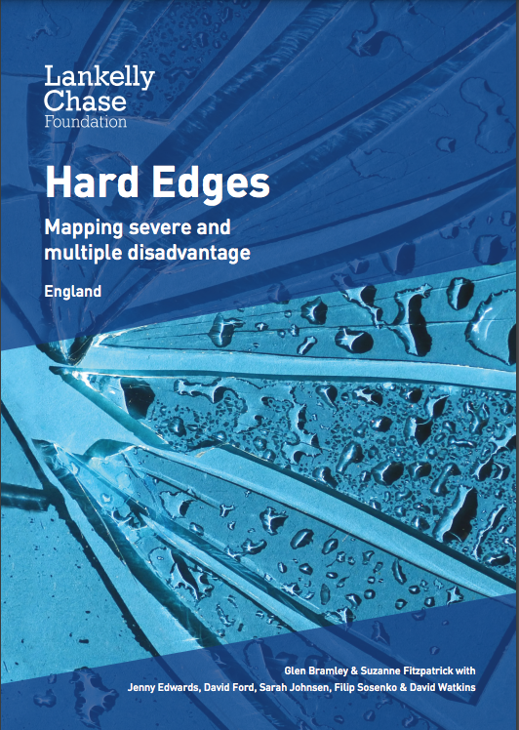
Homelessness and childhood adversity
Bramley/Fitzpatrick et. al. 2015
“Hard Edges: Mapping severe and multiple disadvantage” (SMD)
qualitative scoping exercise, involving a wide-ranging literature and policy review, complemented by interviews with people with direct relevant experience and senior stakeholders in the fields of homelessness, substance misuse, criminal justice and mental health.
The main phase of the study focused on developing a statistical profile of SMD via an integrated analysis of ‘administrative’ (i.e. service use) datasets which, crucially, contained data about service users’ experiences and needs across a range of relevant ‘disadvantage domains’
http://lankellychase.org.uk/wp-content/uploads/2015/07/Hard-Edges-Mapping-SMD-2015.pdf

Slide 13
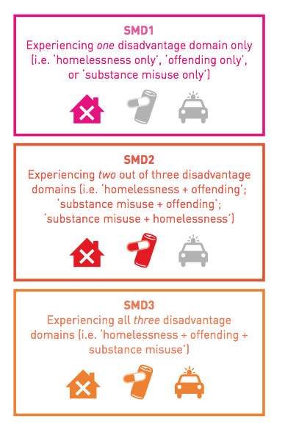
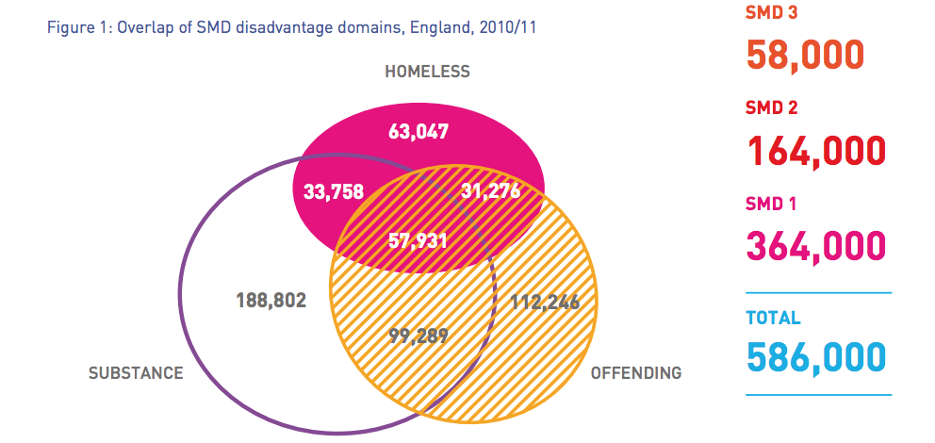
Homelessness and childhood adversity
Bramley/Fitzpatrick et. al. 2015

Slide 14
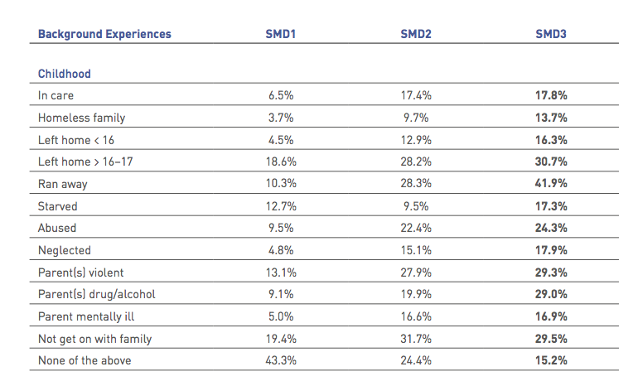
Homelessness and childhood adversity
Bramley/Fitzpatrick et. al. 2015

Slide 15
Part 2: from homelessness to mental illness
“Trauma often happens during homelessness, for example by being a victim or witness of an attack, sexual assault or any other violent event. People can also be re-traumatised by services that leave them feeling powerless and controlled; for example, if they lack privacy and are being challenged in demanding ways”
and
“Homelessness itself can be considered a trauma in multiple ways. Often the loss of a home together with loss of family connections and social roles can be traumatic. This is because ”like other traumas, becoming homeless frequently renders people unable to control their daily lives”
(FEANTSA 2017)

Slide 16
Homelessness and Trauma
85% of those in touch with criminal justice, substance misuse and homelessness services have experienced trauma as children
52% of homeless people have experienced violence in the past year, in contrast to 4% of the general population (Newburn and Rock 2004)
An “alarming amount” of these attacks was found to be committed by the “general public,” especially against rough sleepers, whose presence in public space makes them vulnerable to “unexpected and disturbing” (ibid.) levels of violence.
67% had suffered theft compared to only 1.4% of the general population
43% encountered damage to property compared to a general population rate of 7%.

Slide 17
Homelessness and Trauma
“Homeless people are often seen as a cause of crime, but the research suggests that in fact they are far more likely to be victims than they are perpetrators. Our findings paint a portrait of ongoing abuse and harassment creating situations of extreme vulnerability for homeless people, particularly in public settings. Al-most two-thirds reported having been insulted publicly whilst sleeping rough and distressingly, one tenth said that someone
had urinated on them”
(Newburn and Rock 2004)

Slide 18
Trauma informed care
Services operating on an understanding of trauma and attachment theory
Building trusting relationships
Takes time, patience and respect
Needs trained and resilient staff
See past/through behaviours and emotions
Buildings, services, ethos
Supportive culture for staff, actively promotes their health and well-being
http://housingandwellbeing.org/

Slide 19
Homelessness and ‘social death’
“Social death” refers to the idea that through a forcible severing of the social relations that make them a somebody among other somebodies, a person no longer inhabits the symbolic sphere of the living.
“Social death” has been found to increase thoughts of self-harm in those affected (Steele, Kidd, and Castano 2015), and so it is not surprising that social is often followed by physical death.

Slide 20
‘Social death’ and the brain
Study participants were shown pictures of ostensibly homeless people while an MRI measured their brain activity
“Within a moment of seeing the photograph of an apparently homeless man . . . people’s brains set off a sequence of reactions characteristic of disgust and avoidance. The activated areas included the insula, which is reliably associated with feelings of disgust toward objects such as garbage and human waste. Notably, the homeless people’s photographs failed to stimulate areas of the brain that usually activate whenever people think about other people, or themselves. Toward the homeless (and drug addicts), these areas simply failed to light up, as if people had stumbled on a pile of trash”. (Fiske 2008; see also 2010)

Slide 21
‘Social death’ and the brain
In animal studies, ‘social death’ is comparable to the concept of ‘social defeat’. In species with a rank hierarchy, ‘social defeat’ occurs when an animal loses out to another in a rank conflict.
Studies show that the behavior of animals who have suffered social defeat resembles behaviours seen in humans who suffer from mental illness (e.g. Selten 2016)
The ‘social defeat hypothesis’ of mental health conditions like depression and schizophrenia therefore suggests that mental illness may be the result of evolved brain responses to repeated experiences of social subjugation

Slide 22
Homelessness and harmful substance use
Harmful substance use is often seen as a separate problematic from mental health.
However, substance use can aggravate some mental health conditions, while at the same time, some people attempt to self-medicate mental health conditions through substance use.
In some cases, substance users report that their harmful substance use is a direct consequence of experiencing ‘social death/defeat’.

Slide 23
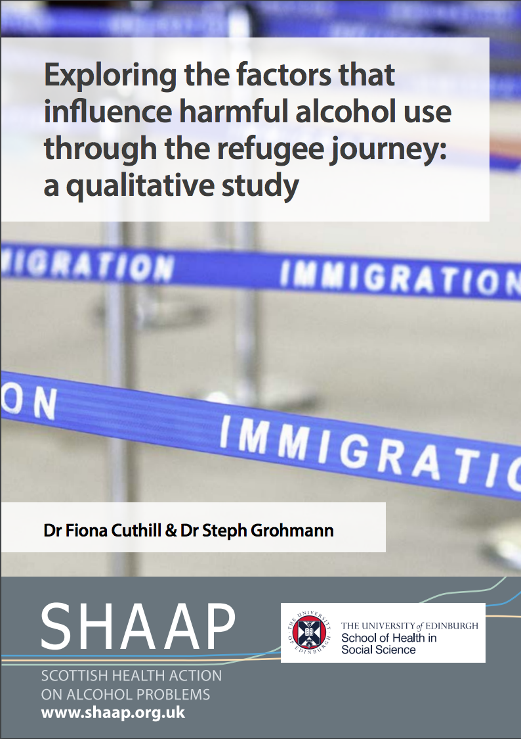
Destitution and harmful substance use
“I’ve seen, I’ve seen, the period I’ve been around I’ve seen that one happening, because if somebody has no hope for tomorrow it becomes unbearable, yeah. If he’s been waiting for years and no answer, no decision, no nothing, you don’t know what it’s for and about what, that is a bad situation. It’s a mental torture at one point, so that can cause somebody to switch on something which is wrong”
file:///Users/steph%201%202/Documents/HIH%202023/refugees-and-alcohol-report.pdf

Slide 24
Accessing support
People experiencing homelessness face significant barriers to accessing health services, especially primary care. These barriers are even greater when someone is also actively engaging in harmful substance use
People who are homeless attend A&E 6 times more often than the general population
They get admitted to hospitals 4 – 8 times more, and once admitted, stay 3 times longer than the general population.
Poor patient experience and lack of trauma-informed care can lead to people disengaging or a lack of trust.

Slide 25
Thank you!

