Slide 1
WELCOME!

Slide 2
Homelessness in a Global Economy

Slide 3
Definition
ETHOS - European Typology on Homelessness and Housing Exclusion
rooflessness (without a shelter of any kind, sleeping rough)
houselessness (with a place to sleep but temporary in institutions or shelter)
living in insecure housing (threatened with severe exclusion due to insecure tenancies, eviction, domestic violence)
living in inadequate housing (in caravans on illegal campsites, in unfit housing, in extreme overcrowding).
FEANTSA is the European Federation of National Organisations Working with the Homeless. https://www.feantsa.org/

Slide 4
How to talk about people who are homeless?
“Homeless people”
“The roofless”
“People who are homeless”
“People experiencing homelessness”
“People affected by homelessness”
“Unhoused people”
….
Using different expressions is usually a well-intentioned attempt at expressing respect. However, these terms have also been criticized for sugarcoating or distorting the situation.
Calling someone “homeless” is not an insult (unless they specifically tell you so).

Slide 5
Homelessness globally

Slide 6
Global homelessness in numbers

Slide 7
Global homelessness in numbers II

Slide 8
Is homelessness on the rise?

Slide 9
Counting homelessness
One challenge of estimating the extent of homelessness world wide is that different countries use different ways of measuring.
The simplest way of measuring is to count the number of rough sleepers found on the streets on a given night of the year (e.g. London). However, this may miss the ‘hidden homeless’, those in housing precarity, or those who intentionally avoid being spotted sleeping rough.
Another option is to use the numbers of those legally entitled to government support due to homelessness. This method misses those who are homeless but do not have a legal claim to help, such as undocumented migrants. In some locations, narrow definitions of who is entitled to help (e.g. “priority need” in England) also make numbers unrealistically low.

Slide 10
New York..

Slide 11
…Rio…

Slide 12
…Tokyo
Homelessness in Tokyo. Source: Kitagawa, Y. (2021). Homeless Policy as a Policy for Controlling Poverty in Tokyo: Considering the Relationship between Welfare Measures and Punitive Measures. Critical Sociology, 47(1), 91–110.

Slide 13
Causes of homelessness
Explanations of what causes homelessness usually fall into one of two categories: individual vs socioeconomic
Individual causes can e.g. be: lack of income, mental illness, harmful substance use, relationship breakdown….
Socioeconomic causes can e.g. be: housing- and labour market shifts, large scale displacement, welfare cuts….

Slide 14
Homelessness and the global economy
Example UK:
Post-WWII, homelessness increased significantly due to destruction of housing and lack of building materials and builders.
In 1951, new housing minister Harold Macmillan pledged to build 300,000 new houses per year. This target was reached in 1953. Until 1980, social housing stock was increased to 4.4 million units
Under Prime Minister Margaret Thatcher, social housing building was significantly slowed down due to the government’s belief in private property ownership as a moral good. Thatcher’s “right to buy” policy allowed social housing tenants to buy their homes at a cheap price as a way of privatizing them.
There are now 1.2 million fewer social homes than in 1980.
As a result, many UK cities suffer a perpetual “housing crisis”

Slide 15
Homelessness and the global economy
From the 1980s shifts in the financial system such as the abolition of the gold standard led to cyclical financial crises and economic instability
Neoliberalism, the emerging political ideology of the time, saw the reason for this in too much state interference suppressing individual responsibility
Neoliberals such as Thatcher and Reagan aimed to roll back the welfare state and “incentivise” people to build private wealth
A key concept of this programme was ‘asset based welfare’ – social security through the individual accumulation of private property

Slide 16
Homelessness and the global economy
Housing is a key component of asset based welfare. Neoliberal policies therefore encourage private home ownership as a means of provision for the future
Since few people can afford to buy property in cash, the rise of private home ownership came with a proliferation of financial products such as mortgages
Mortgage debt can be further monetized by being turned into other financial products – these are what caused the 2008 financial crisis
The development of a market in financial products is called financialisation

Slide 17
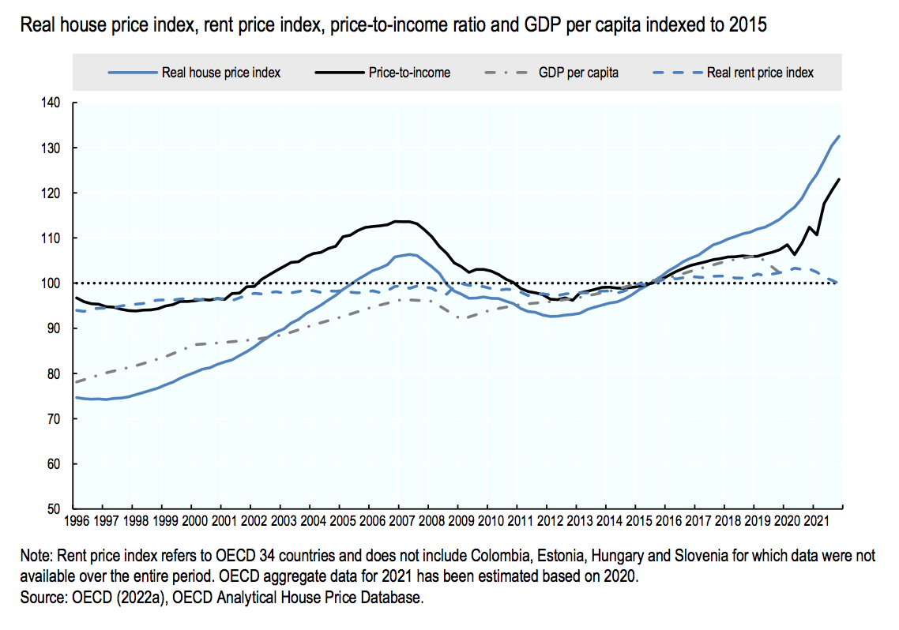
Homelessness and the global economy
In the past four decades, housing markets have become increasingly financialized – housing is now widely seen as an investment opportunity. As a result, house prices globally have steadily risen.

Slide 18
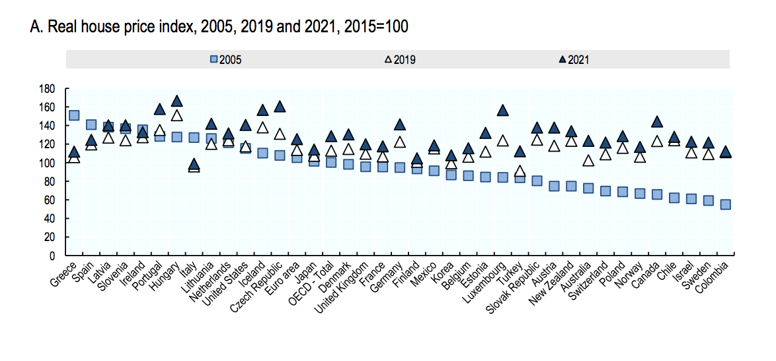
Homelessness and the global economy
This graph from OECD shows that since 2005, house prices have risen steeply as investment capital has arrived in many countries that were previously relatively low price

Slide 19
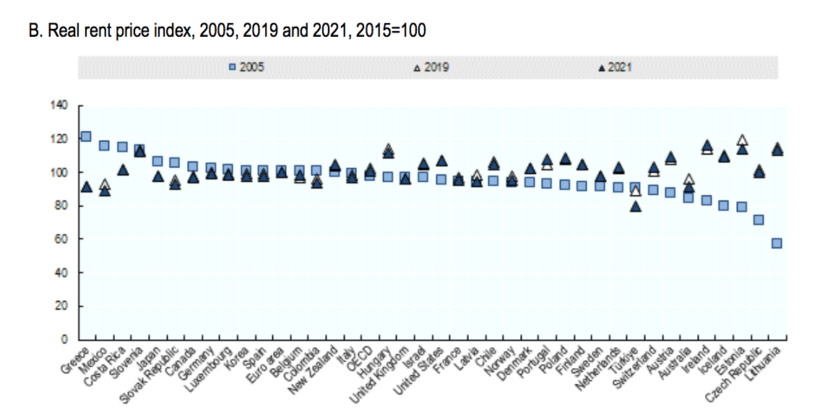
Homelessness and the global economy
Rising house prices lead to less available housing stock and push people into private rental markets. The increasing demand drives up rents. Rising house prices therefore also mean fewer, less affordable rental properties

Slide 20
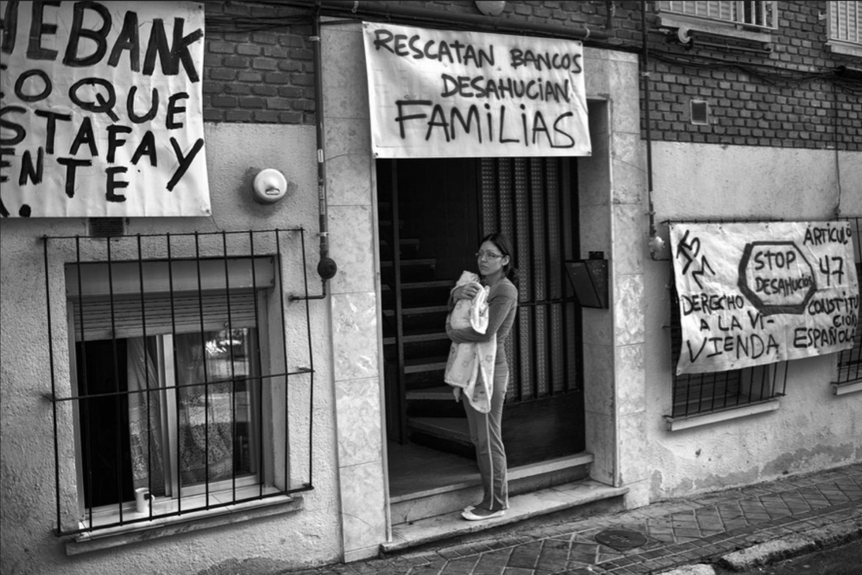
Homelessness and the global economy
The result is a global (urban) housing crisis.
More than 1.8 billion people around the world do not have adequate housing
An estimated 15 million people are forcibly evicted every year
150 million are homeless
(source: Urbanet)

Slide 21
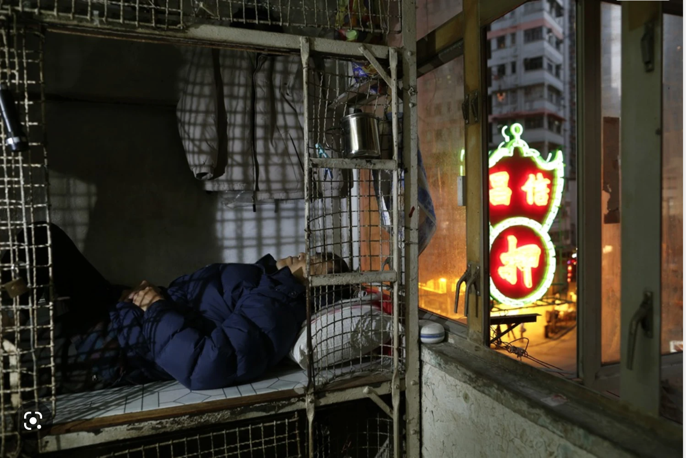
From global to local
Example: Hong Kong
The monthly rent allowance from the Social Welfare Department is $2515
the average cost of a bedspace in a 10.5 sq ft coffin home is $2,500
The average waiting time for public rental housing is 5.6 years – for single males it is as much as 3-4 times longer.
In the private rental market there is a chronic shortage of affordable housing.
Unemployment reached a 15 year high in 2020 due to the pandemic, resulting in widespread job loss in Hong Kong and an increase homelessness.
(source: https://impacthk.org/)
NBC

Slide 22
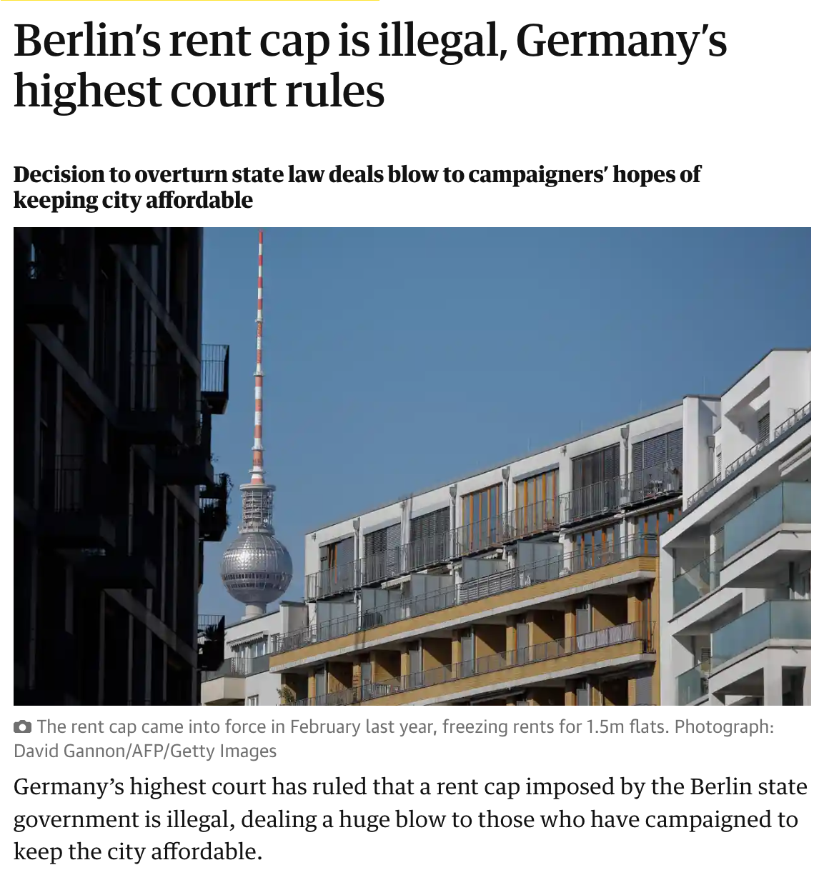
From global to local
Example: Berlin
Berlin rents increased 85% between 2007 and 2019,
80% of Berliners rent their homes
Unemployment rose by 10.6% in Berlin in 2020
The number of people who are homeless, including those in temporary accommodation, is over 30.000
In Jan 2020, the people of Berlin voted to expropriate commercial landlords.
The Guardian

Slide 23
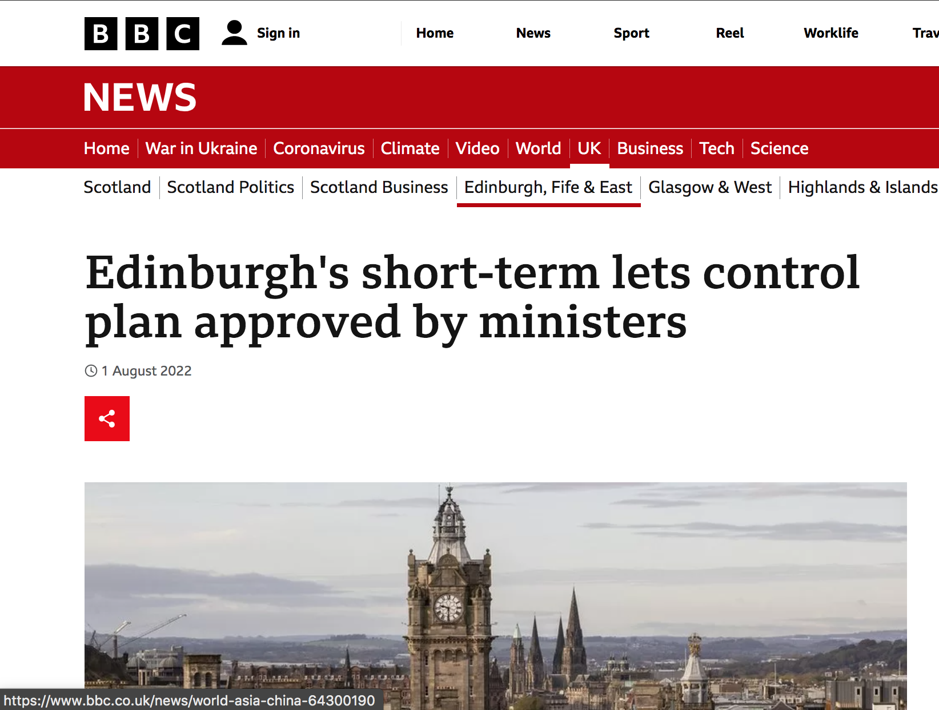
From global to local
Example: Edinburgh
Edinburgh is the least affordable city in Scotland
The average rent has increased by 42.3 per cent between 2010 and 2018
1/3rd of Scottish short term rentals are in Edinburgh. Platforms such as AirBnB have been increasingly blamed for a lack of affordable housing for locals.
In 2022, the Scottish Government introduced licensing for short-term-lets and is planning further restrictions.

Slide 24
Thank you!

