Slide 1
Welcome to
Research Ethics in PPIE and Participatory Research
Presented by
Dr Steph Grohmann
Senior Program Manager Research Ethics and Inclusion

Slide 2
Outline:
What is research ethics and why do we need it?
Some principles of research ethics
Different understandings of research ethics
Does PPIE/participatory research need ethics?
Potential ethical pitfalls to consider in PPIE/participatory research
Mini ethics checklist for PPIE/participatory research
Where can I get support for my PPIE study/formal ethics review?
Space for comments and questions

Slide 3
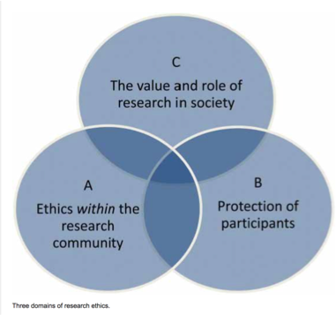
What is ‘research ethics’?
General conduct expected of scientists ‘re plagiarism, data falsification, conflict of interest… (a.k.a “research integrity”)
Ethics in research with human participants: how to not harm the people your research is about/for
The responsibility of science towards society: how to use public funds, make results applicable, avoid social harm
Im age credit: Reidun Tangen via Researchgate

Slide 4
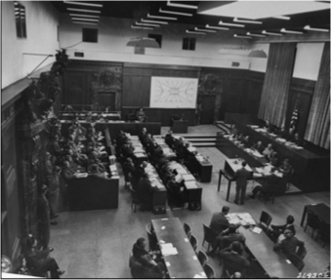
Why do we bother?
The history of (especially medical) research is a history of human rights abuses and the exploitation of vulnerable groups
Examples:
Early vaccine studies
Nazi experimentation
Studies on enslaved people
Racist science (e.g. Tuskegee study)
Psychiatric interventions (e.g. lobotomies)
Psychological experiments (Stanford Prison Study, Milgram Experiment…)
The Nuremberg doctor’s trial, public domain

Slide 6
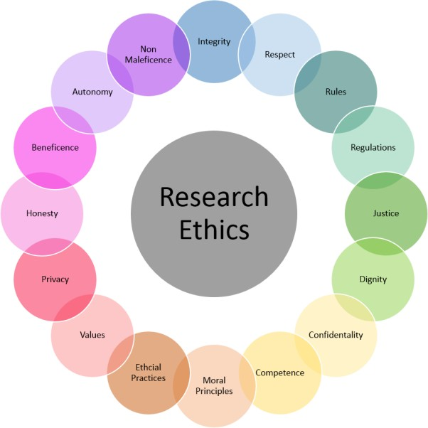
General principles…
Informed Consent
Beneficience and non-maleficience
Respect for Persons
Confidentiality and data protection
Conflict of Interest
Social Justice

Slide 7
…and some not so general ones
Reflexivity
Epistemic/cultural/moral relativism
Cultural and intellectual property
Anonymity vs. Recognition
Trauma-informed approaches
Political economy considerations
…

Slide 8
One ethics – or many?
In practice, ‘research ethics’ can refer to:
Institutional ethics procedures (law-oriented, bureaucratic, ‘box-ticking’)
Professional ethics systems in different disciplines (reflexive, qualitative, adaptive)
General ethics (socio-culturally specific)
These levels can and do come into conflict!
?
Examples:
Rigid bureaucratic procedures vs. the needs of culturally specific human subjects
Legal liability vs. moral responsibility
Managerial university governance vs. freedom of science
And: ‘for-profit’ science produces inherent institutional conflicts of interest

Slide 9
Involving the public in research is a good thing for democracy!
A multilayered phenomenon
General ethics
How do we make sure our refugee participants understand what it says in our consent form?
Professional ethics
Admin is making us fill in another %$@&# form!!!
Bureaucracy

Slide 10
Is there an ‘Ethics of PPIE’?
“The rationale for PPI includes a moral/ethical dimension, based on the argument that those who have lived experience of the phenomenon being researched (eg., a health condition) should also have a voice in related research” (Kaisler et. al. 2021)
“Currently, there is no requirement for formal ethical scrutiny of processes for engaging and collaborating in this way. This may leave researchers in a position where they unwittingly fail to consider in full the needs, capacity, level of involvement and required resources prior to approaching or working with PPIE
members” (Troya 2019)
“How, then, can we liberate from a disproportionate ethics regime this family of approaches to intervention design which have many goals and methods in common? How can we avoid constructing people as vulnerable participants rather than partners, with agency?” (Locock and Boaz 2019)

Slide 11
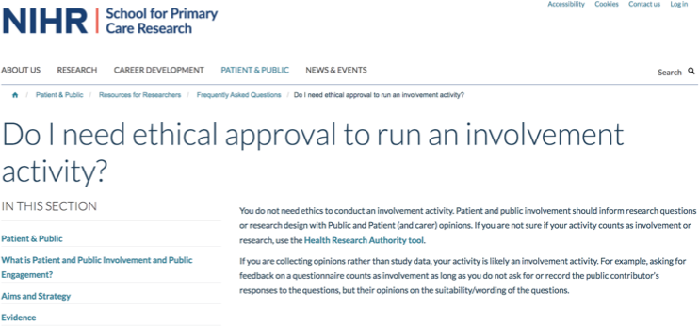
Does PPIE need ethics review?

Slide 12
So…does PPIE need ethics review?
In Austria, only experimental medical studies have a legal requirement for ethics review
Medical ethics committees often decline review for non-experimental methodologies as this is not their area of expertise
Timeline collisions: involvement often starts at the design stage, but ethics review comes later
Guidance from many internationally leading institutions in health research exempts PPIE from ethics review
But:
There is mounting criticism about PPIE/participatory research being an ethical ‘Wild West’
Publishers and funders increasingly want to see proof of ethics review for ALL activities involving human participants

Slide 13
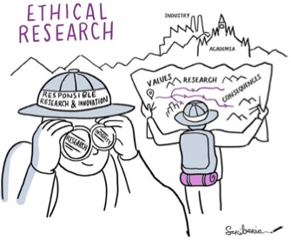
Challenges for ethics practice in PPIE research
Different understandings of what we mean by ‘ethics’ lead to conflicts
Different institutional and research cultures don’t always translate between international contexts
Institutional timeframes and remits do not map well onto PPIE contexts
Lack of clear guidance: what to look out for in PPIE research?
Some ethical pitfalls are specific to PPIE research

Slide 14
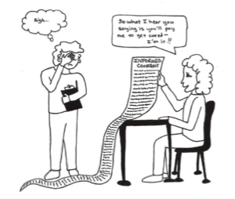
Potential pitfalls
Participation becoming a ‘fig leaf’ to avoid bureaucracy
Lack of oversight over ethical treatment of co-creators
Lack of redress for participants in case of complaints
Potentially less care ‘re data protection/anonymity
Blindness to socio-cultural power differentials
Lack of reflection on potential harms through involvement (e.g. trauma)
Lack of reflection on economic aspects of collaboration (‘yay, free labor!’)
Lack of reflection about participant’s own perspective

Slide 15
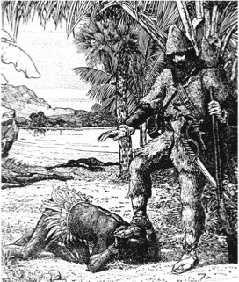
How not to ethics 1:
‘The Noble Savage’…
19th century colonial idea that indigenous people are ‘pure, good and child-like’, unlike Westerners
Jean-Jacques Rousseau: only the “uncorrupted savage” can be truly virtuous
Famous example: Robinson Crusoe and ‘Friday’
But: Positive stereotypes are still stereotypes
Othering and homogenizing ANY community is the first step towards dehumanizing them
Illustration for ‘Robinson Crusoe’, public domain

Slide 16
…to ‘The Noble Patient’?
“Patients/participants are always pure and good and have only the best interests of science/society in mind. Any patient is as good as any other, so I’ll just go with the low hanging fruit to save time”.
But:
Patients/participants do not all think and feel alike. Sometimes they disagree profoundly among each other. Some patient communities are in an ongoing state of conflict (e.g. various disability communities over ‘cure vs. acceptance’ debates).
Patients/participants are individuals, subject to bias, personal preference and prejudice – just like us.
‘Respect for persons’ also means resisting the temptation to ‘other’ and/or homogenize participants

Slide 17
How not to ethics 2:
‘Goodbye and thanks for all the scientific capital!’
Thanks to neoliberalism, scientific careers demand the accumulation of social capital in form of publications, citations, and other ‘performance indicators’. Our participants are helping us to do this. They contribute:
‘Open Innovation’ does not mean pillage and plunder!
social capital: contacts, community access, credibility
knowledge capital: data, skills, experience
cultural capital: insights into the life-worlds of research consumers/beneficiaries
ethical capital: their participation makes us look better to funders and publishers
We owe it to them to consider what constitutes fair compensation for this investment in our work. This can include material rewards as well as public recognition.

Slide 18
How not to ethics 3:
‘How were we supposed to know this would upset them?’
All participatory research, but especially research involving patients, poses a risk for distressing or traumatic material to surface
This is even more likely when working with marginalized or vulnerable groups and their loved ones
We cannot know in advance what exactly may cause distress to our participants, but we can think about what is likely to, especially in terms of responses to illness and suffering
We should be prepared for the eventuality of a crisis by having a trauma response plan, e.g. including a process to refer participants to psychosocial emergency services
Participatory research on illness and other distressing topics needs to be trauma-informed and have a risk-mitigation strategy in place

Slide 19
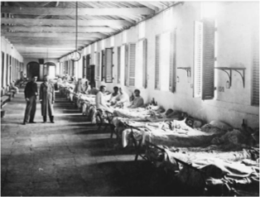
How not to ethics 4:
‘…but we did everything the ethics committee asked for!’
In the early 1900s, Walter Reed (USA) conducted experiments to determine the cause of yellow fever.
He exposed Spanish immigrant workers in Cuba to the disease. Participants were promised $100 (ca. $3500 today), twice that if they developed symptoms.
Six participants died, including two researcher-volunteers (Reed himself declined to self-experiment).
The participants all signed consent forms, some translated into Spanish. Reed’s study today counts as the first use of consent forms in medical history.
Image: public domain
Bureaucracy does not replace a conscience

Slide 20
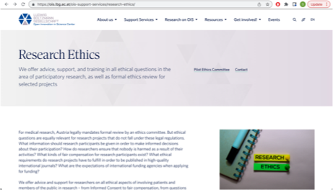
Our support services
The LBG OIS Center offers advice, support and training on all things research ethics
Troubleshooting available any time
We’re always happy to answer your questions:
ethics@lbg.ac.at steph.grohmann@lbg.ac.at

Slide 21
Key takeaways:
Research ethics is a multidimensional and contested set of practices
PPIE/participatory research is not an ethics-free zone
‘Patients/participants’ are individual persons, not a homogenous mass
Participation is a contribution to our livelihood and should be honored as such
Participatory research must be trauma-informed and risk-aware
Bureaucracy can help to monitor ethics but it does not replace a moral compass
The LBG OIS Center is here to help!

Slide 22
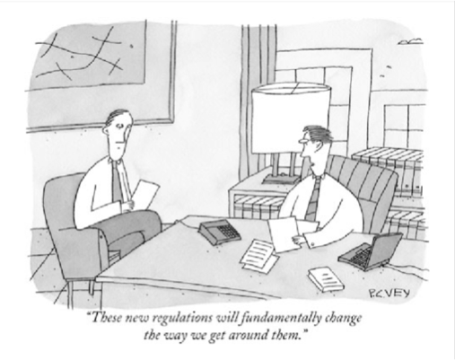
Thank you!!!

